Slide 1
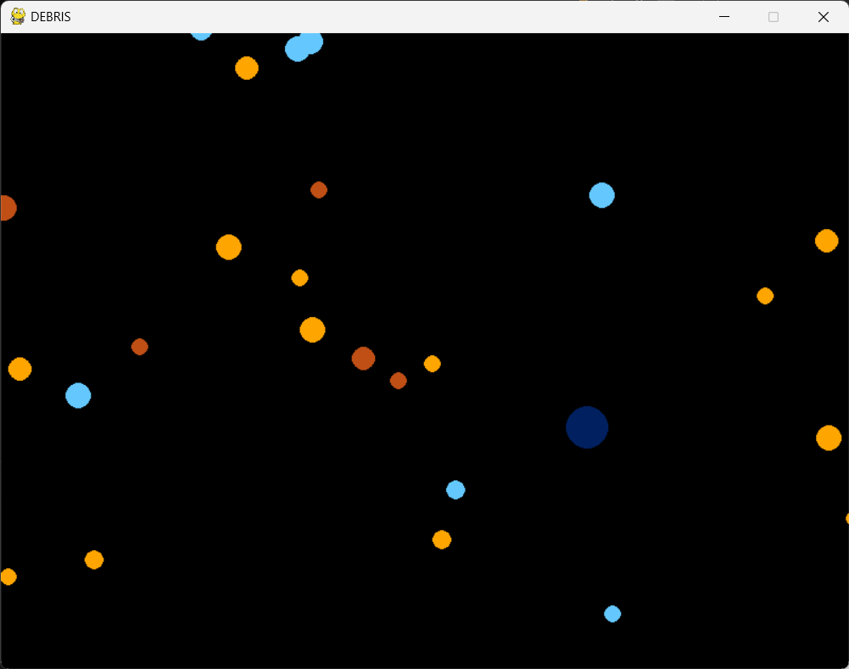
base - v2_p3 - asteroid + player
This stage of the game introduces a player character (dark blue circle) and some asteroids (smaller, brightly coloured circles) that the player must evade.
Player

Slide 2
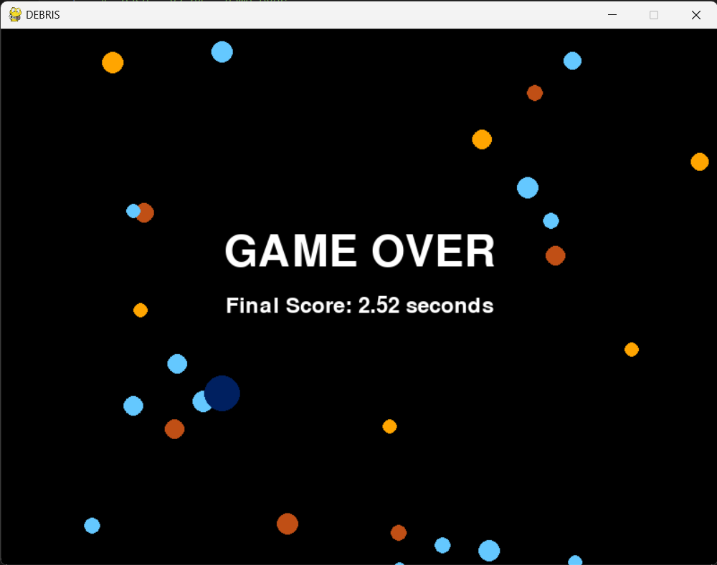
base - v2_p4 - game over
This stage of the game introduces a ‘game over’ functionality to the game, building upon the collision functionality introduced in v2_p3 (version 2 part 3)

Slide 3
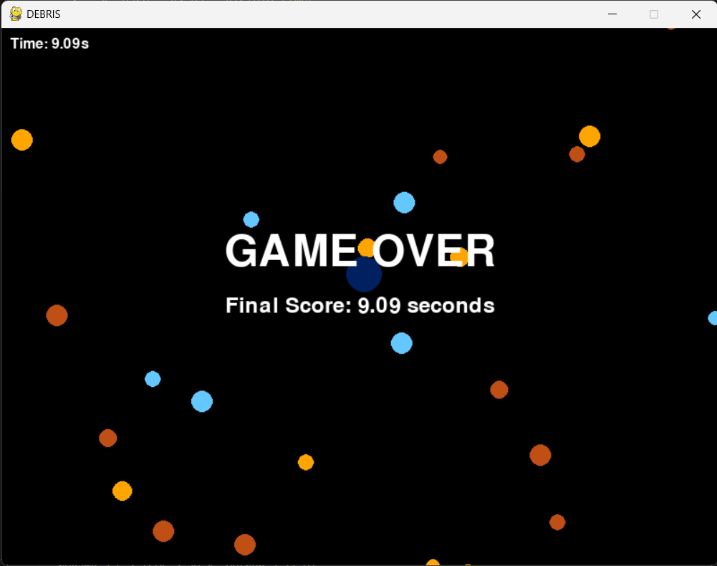
base - v2_p5 - visible timer
This stage of the game makes the timer visible.

Slide 4
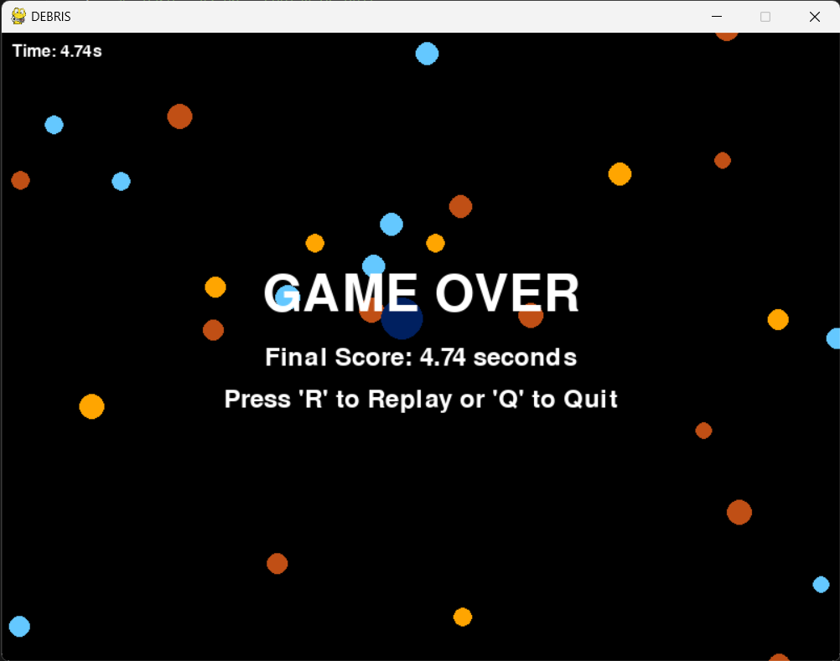
SCREENSHOT GOES HERE
base - v2_p6 - replay or quit
This stage of the game introduces a ‘replay’ or ‘quit’ feature, enabling the player to player again without having to close the game and re-open the game.

Slide 5
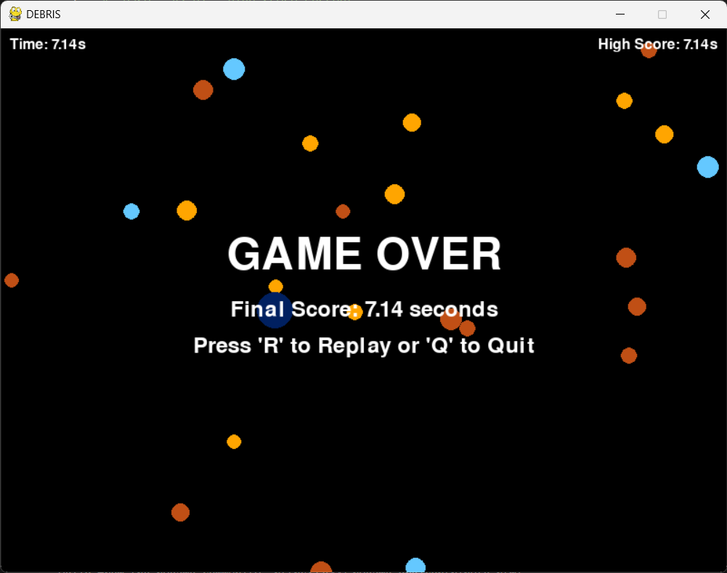
SCREENSHOT GOES HERE
base - v2_p7 - high score current
This stage of the game introduces a ‘high score’ functionality to the game and records the player’s highest score of the current session.
The only updates if the player’s final score is greater than their current high score.

Slide 6
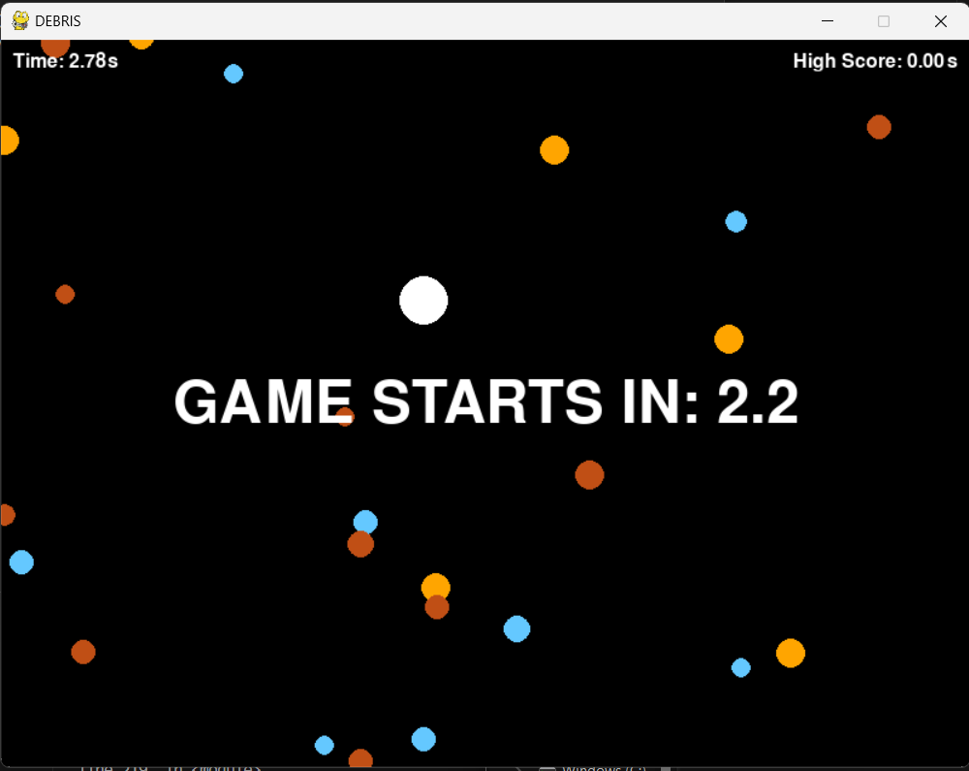
SCREENSHOT GOES HERE
base - v2_p8 - game starts in 321
This stage of the game introduces an invulnerability functionality that keeps the player invincible for the first 5 seconds of the game.

Slide 7
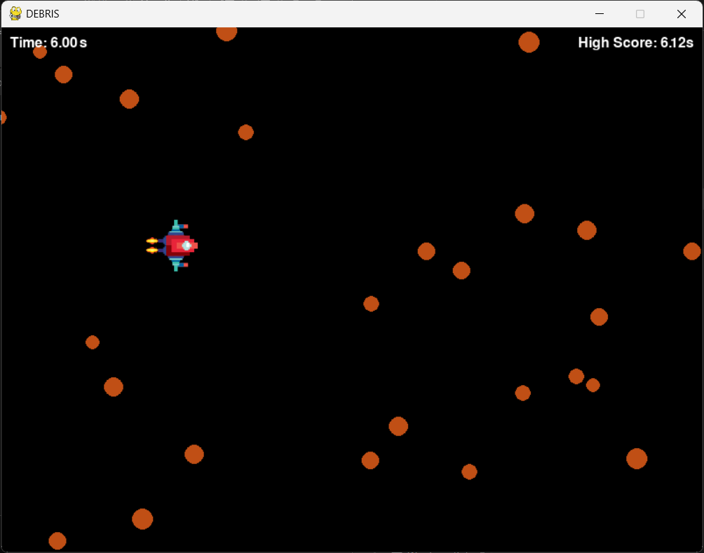
SCREENSHOT GOES HERE
base - v2_p9 - sprite for player
This stage of the game introduces more graphics to the game, turning the player into an actual spaceship instead of a dark blue circle.

Slide 8
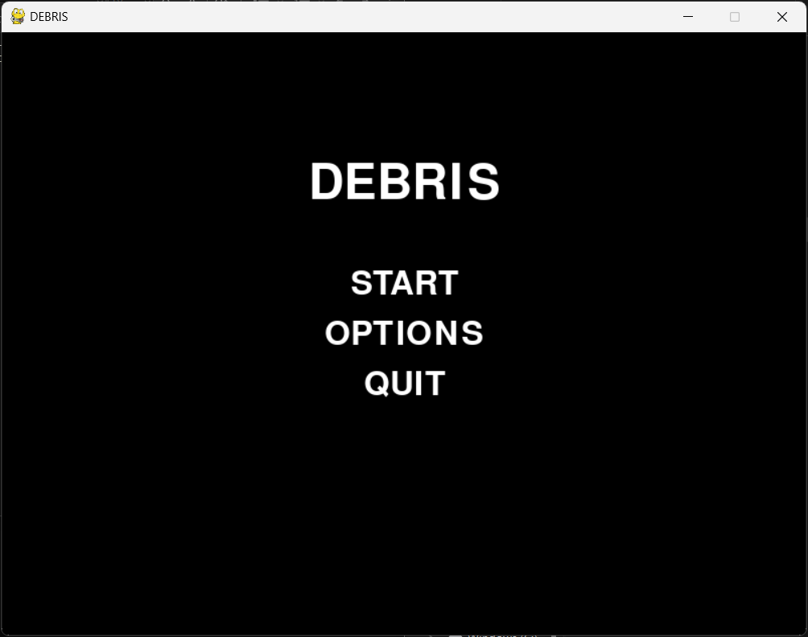
SCREENSHOT GOES HERE
base - v2_p10 - start screen + delayed timer
This stage of the game introduces a start screen, which gives the player control over when the game begins.

Slide 9
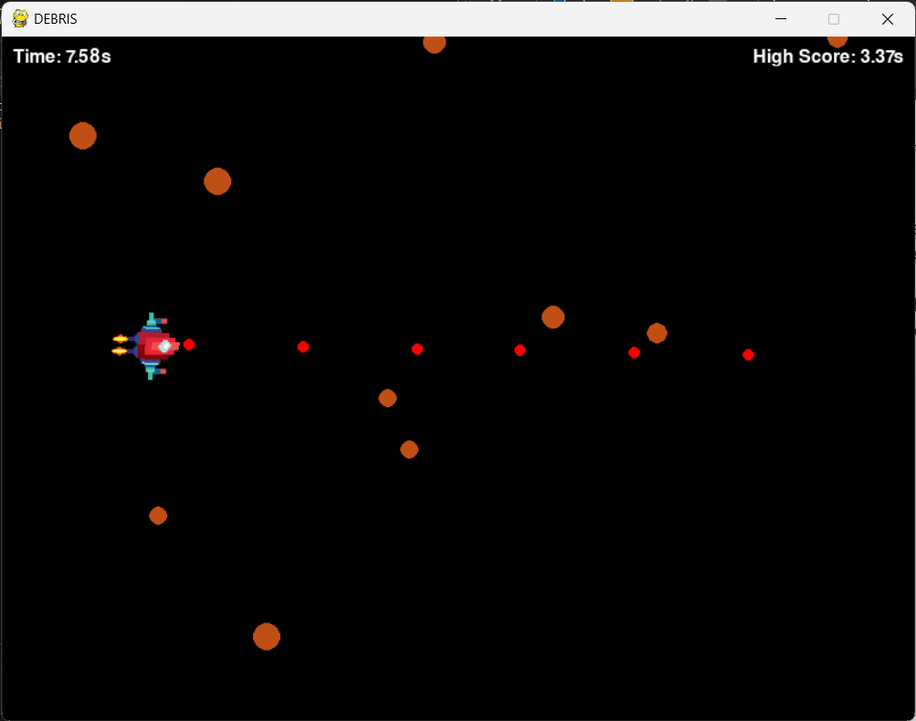
SCREENSHOT GOES HERE
base - v2_p11 - player weaponry L1
This stage of the game introduces player weaponry.
Single ‘left-click’ fires a single red, circular projectile.
Projectile from player weapons

Slide 10
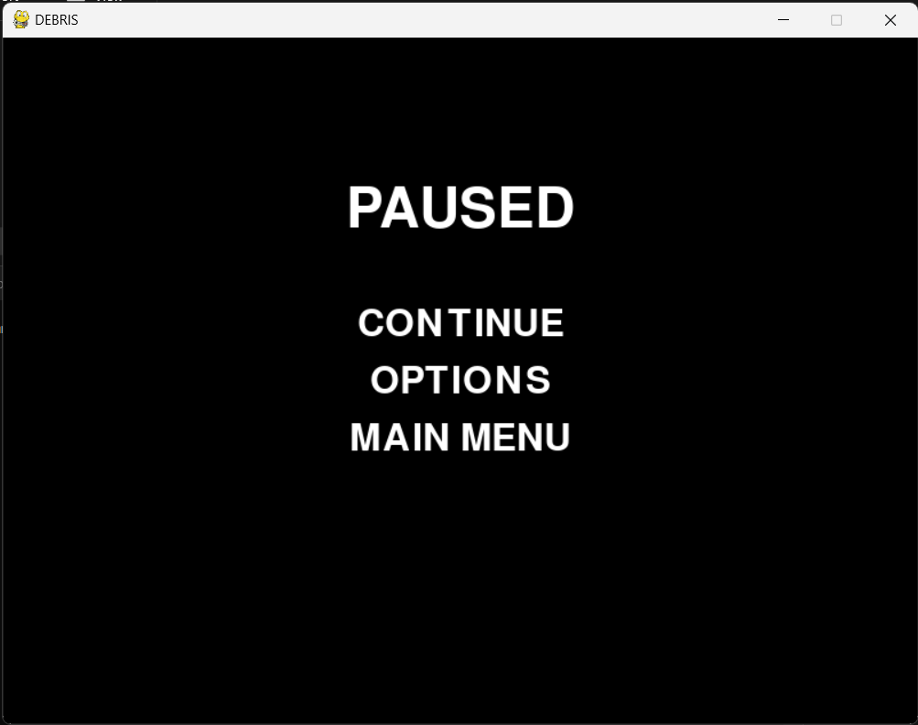
SCREENSHOT GOES HERE
base - v2_p12 - pause continue return
This stage of the game introduces a PAUSE functionality and menu into the game, enabling players to postpone gameplay if need be and continue from where they left off.

Slide 11
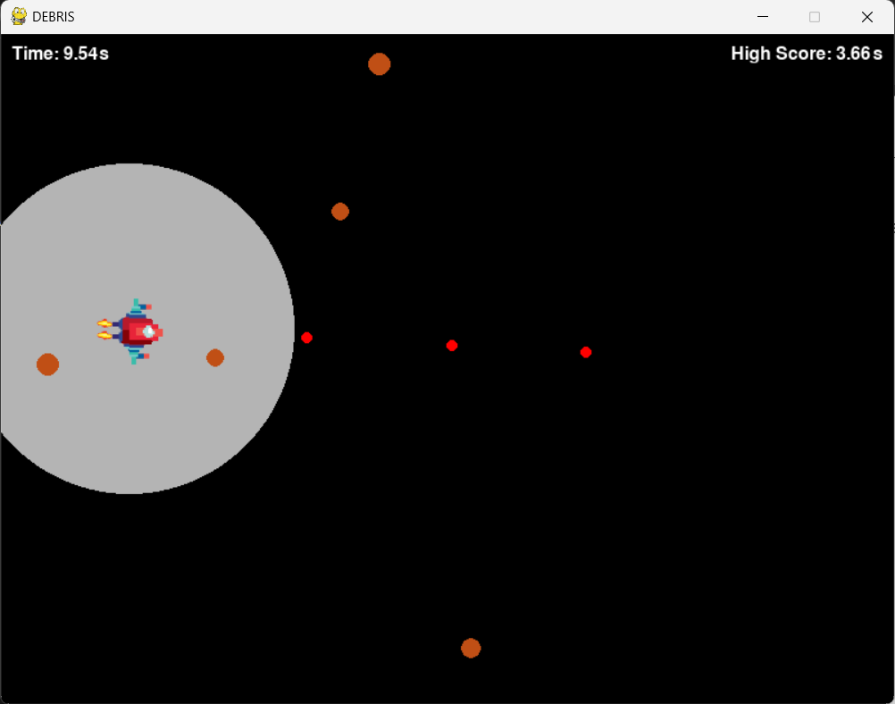
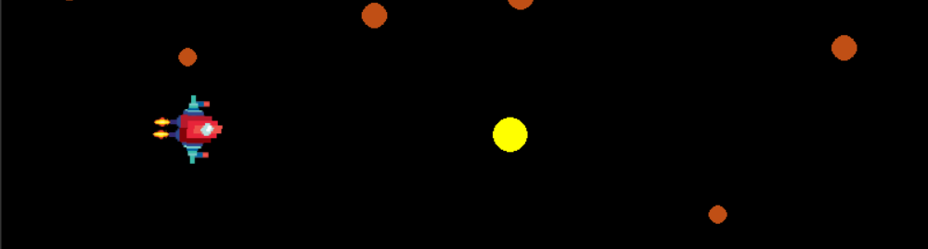
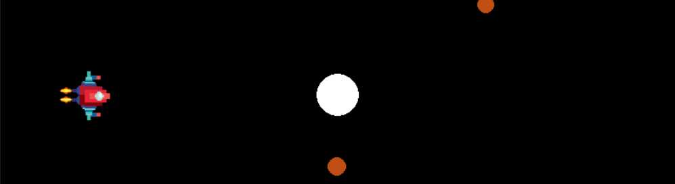
SCREENSHOT GOES HERE
Projectile from player weapons
base - v2_p13 - player weaponry L2
This stage of the game introduces further weaponry to the player’s arsenal.
The player can fire larger, more powerful projectiles by holding left click. The longer the player holds left click, the more powerful the projectile.
Projectile from player weapons
Projectile from player weapons

Slide 12
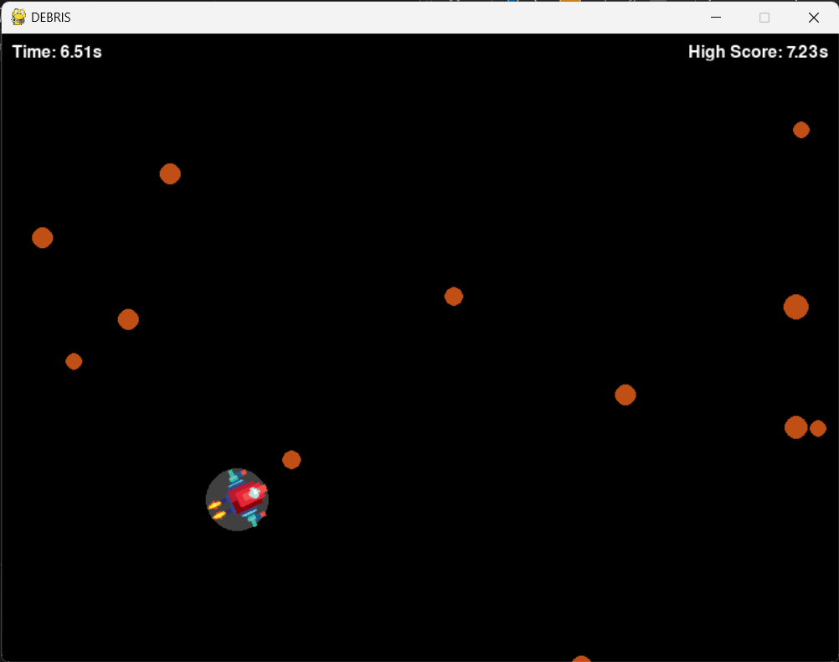
SCREENSHOT GOES HERE
base - v2_p14 - charging effect
This stage of the game introduces a slightly modified visual indicator that the player is charging up their attack.

Slide 13
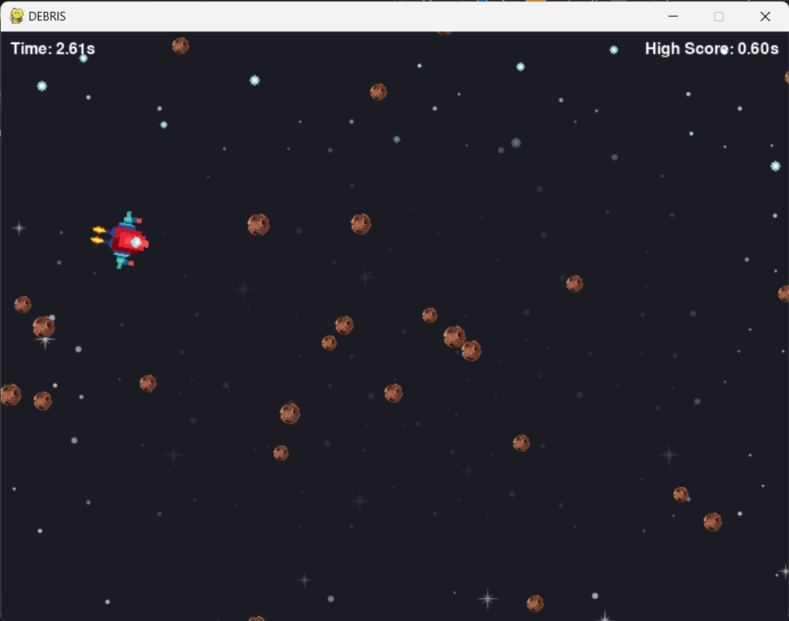
SCREENSHOT GOES HERE
base - v2_p15 - background + real asteroids
This stage of the game introduces both a more fitting background (outer space) and asteroid that actually look like asteroids rather than mere circles.

Slide 14
SCREENSHOT GOES HERE
base - v2_p16 - sound and image fx (malfunctional)
This stage of the game introduces sound fx and enables the destroyed asteroids to briefly transform into exploded versions of themselves.

Slide 15
SCREENSHOT GOES HERE
base - v2_p17 - sound fx volume modulate
This stage of the game introduces sound effects to the explosions of both the projectiles and the enemies.

Slide 16
SCREENSHOT GOES HERE
base - v2_p18 - music
This stage of the game introduces background music from the Nitrome game Fat Cat.
It also makes use of game over music from Sonic games.

Slide 17
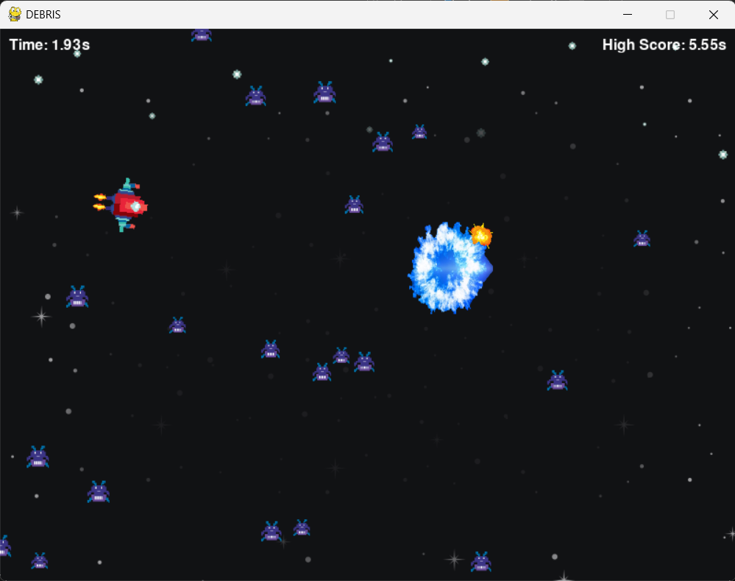
SCREENSHOT GOES HERE
base - v2_p19 - more sprites
This stage of the game turns the asteroids into actual enemies with the appearance of actual enemies.
The projectiles fired by the player have also been modified to appear as actual projectiles rather than mere circles.

Slide 18
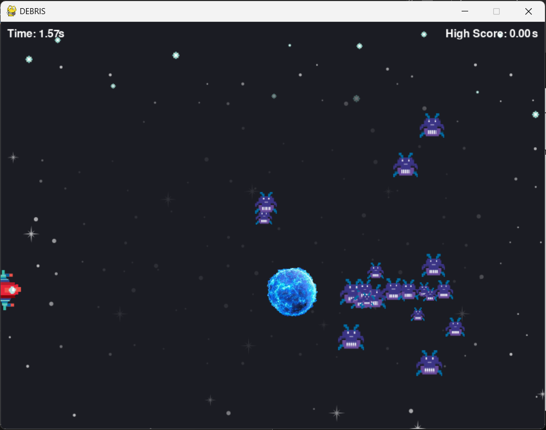
SCREENSHOT GOES HERE
base - v2_p20 - new enemy logic
This stage of the game modifies the initial game mechanics.
Old mechanics: enemies floating randomly throughout the screen.
New mechanics: enemies moving from the right part of the screen to the left, only changing Y axis to follow player.

Slide 19
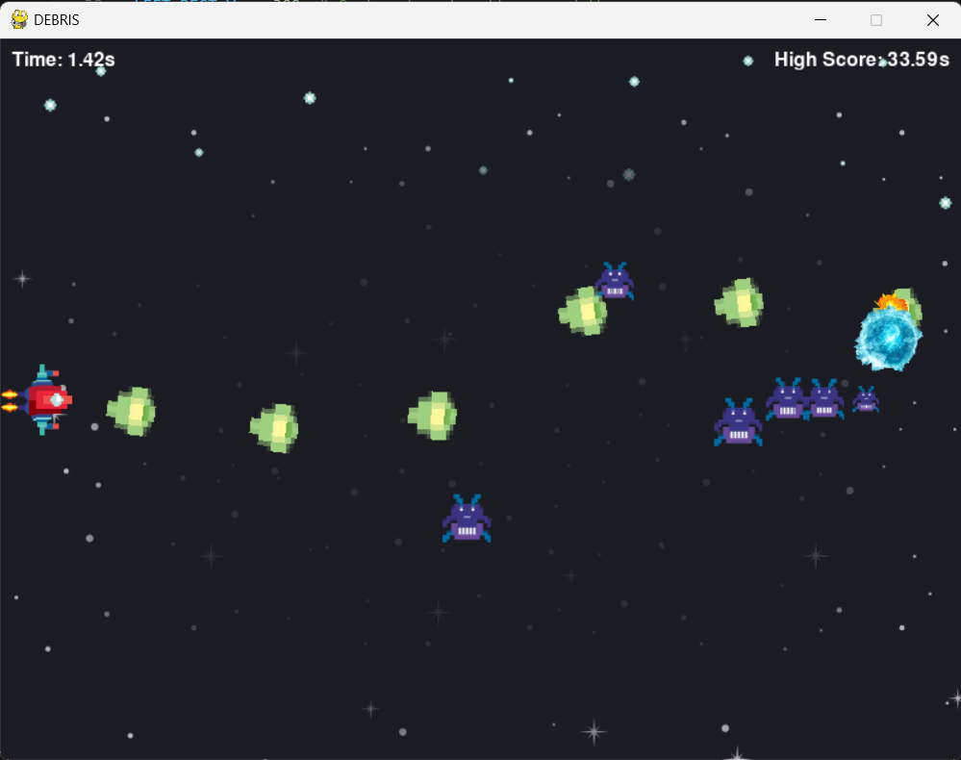
SCREENSHOT GOES HERE
base - v2_p21 - fully auto weapon added
This stage of the game introduces further weaponry, granting the player a fully automatic firing option by holding right click.

Slide 20
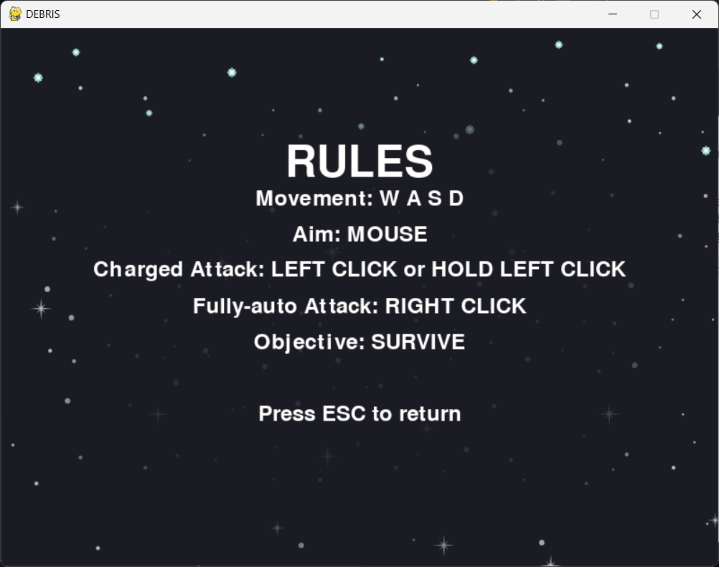
SCREENSHOT GOES HERE
base - v2_p22 - rules of the game
This stage of the game introduces a ‘rules’ menu that enables players to actually have a place they can visit in order to discover the controls of the game.

Slide 21
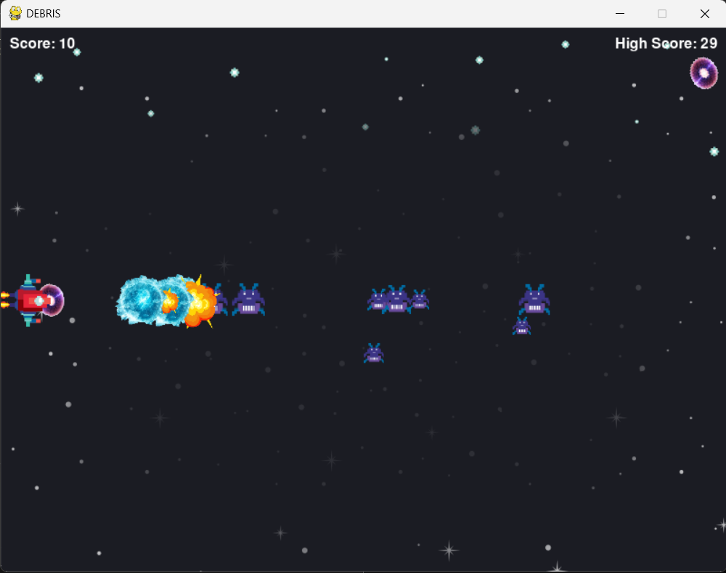
SCREENSHOT GOES HERE
base - v2_p23 - score now = kills
This stage of the game introduces a new score system that places the ‘timer = score’ framework with a ‘kills = score’ framework.

Slide 22
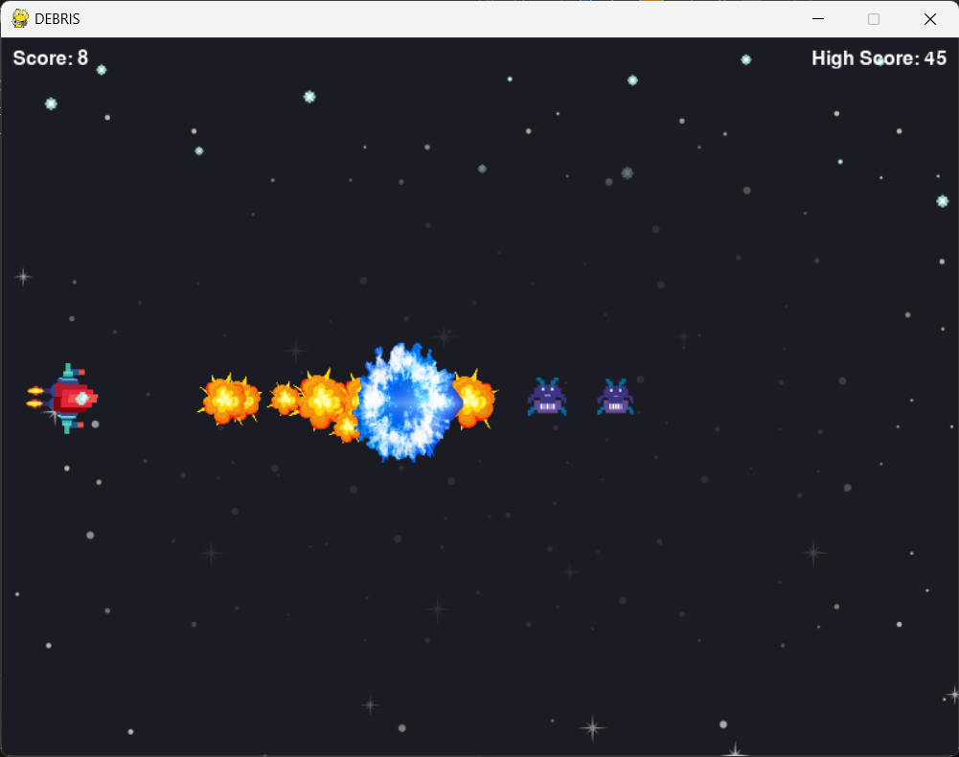
SCREENSHOT GOES HERE
base - v2_p24 - slight weapon improvement
This stage of the game improves the potency of the player’s weaponry, enabling the player to take out more enemies with a single charged shot.

Slide 23
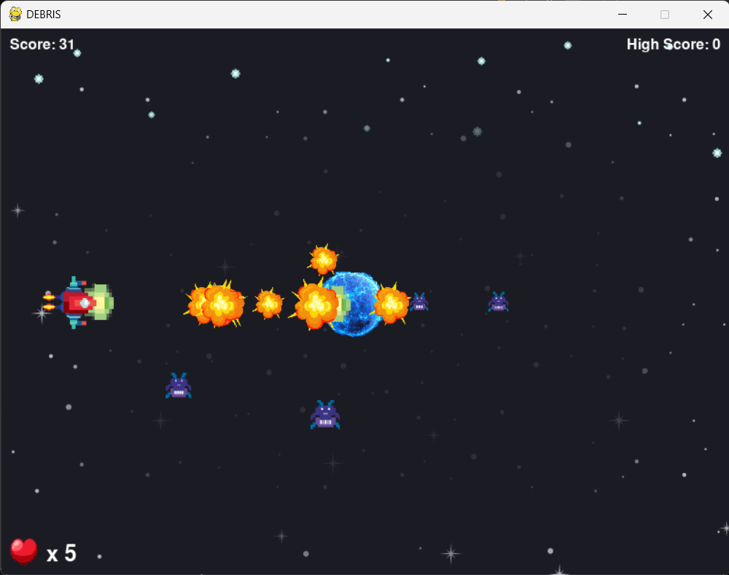
SCREENSHOT GOES HERE
base - v2_p25 - health loss system
This stage of the game introduces a heart counter, a health bar equivalent.
This makes the game a bit less frustrating to play as the player gains 5 hearts, thus 5 opportunities to not get hit by enemies.

Slide 24
SCREENSHOT GOES HERE
base - v2_p26 - improved sound fx
This stage of the game introduces more sound effects, giving the parts of the gameplay that still needs sound effect, such as weapon fire and attack charging.

Slide 25
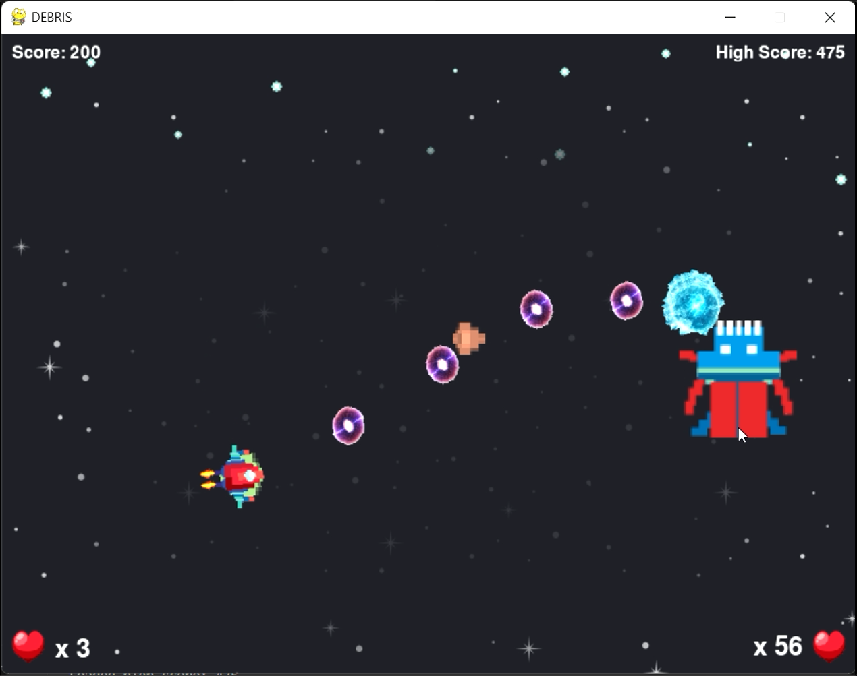
SCREENSHOT GOES HERE
base - v2_p27 - boss fight + music
This stage of the game introduces a boss fight that begins once the player has destroyed a certain number of enemies.
A VICTORY screen, as well as victory music, is also introduced.

Slide 26
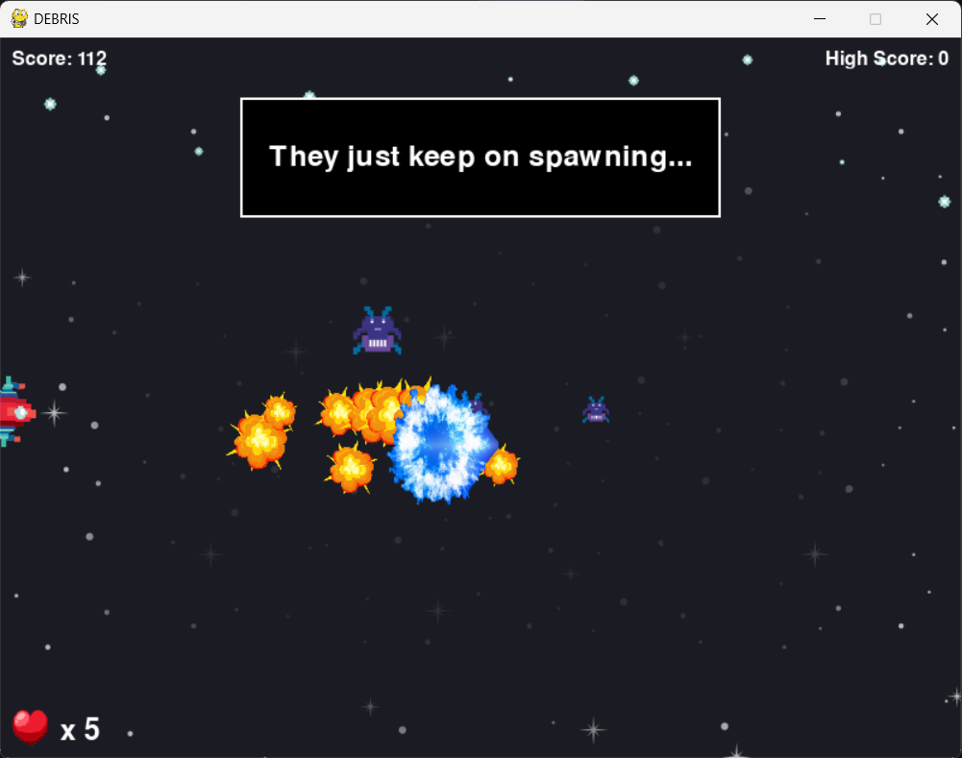
SCREENSHOT GOES HERE
base - v2_p28 - speech boxes
This stage of the game introduces speech boxes which are automatically triggered once the player has defeated a certain number of enemies.

Slide 27
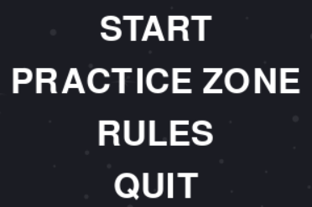
SCREENSHOT GOES HERE
base - v2_p29 - practice zone
This stage of the game introduces a practice zone into the main menu that the player can use to familiarise themselves with the controls of the game before they get to playing.
The practice zone is also a safe zone as there are no enemies at all nor timer.
The player can return from the practice zone to the main menu at any time by pressing ESC key. The practice zone can only be accessed from the main menu, however.

Slide 28
SCREENSHOT GOES HERE
base - v2_p25 -
This stage of the game

